Slide 1
Nerves
Day 2

Slide 2
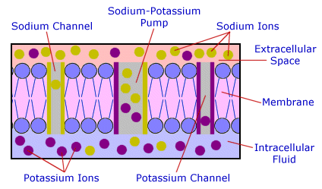
Cell Membrane Potential
A cell membrane is usually polarized as a result of unequal ion distribution.
Distribution of Ions
Due to pores and channels in the membranes that allow passage of some ions but not others.
Potassium ions pass more easily through cell membrane that do sodium ions.

Slide 3
Resting Potential
A high concentration of sodium ions is on the outside of the membrane, H.C. of potassium on inside.
Many negatively charged ions inside a cell.
Resting Potential
More positive ions leave cell than enter
Outside develops + charge, inside develops – charge.

Slide 4
Potential Changes
Stimulation of a membrane affects the membrane’s resting potential.
When its resting potential becomes more positive, a membrane becomes depolarized.
Potential changes are due to summation.
Achieving threshold potential triggers an action potential.

Slide 5
Action Potential
1/1000 of a second to occur.
At threshold, sodium channels open and sodium ions diffuse inward, depolarizing the membrane.
About the same time, potassium channels open and potassium ions diffuse outwards, repolarizing the membrane
Rapid change in potential is Action Potential
Many action potentials can occur before active transport reestablishes the resting potential.

Slide 6
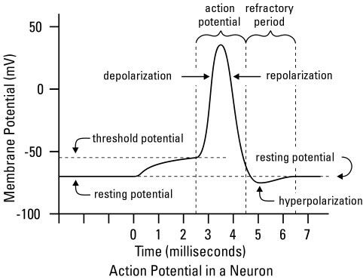
Action Potential

Slide 7
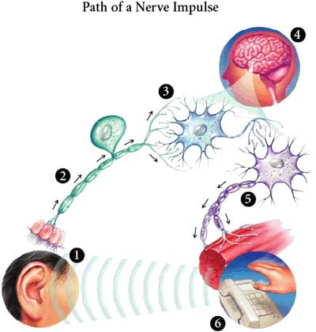
Nerve Impulse
Impulse Conduction
Unmyelinated fibers conduct impulses over entire surface
Myelinated fibers conduct impulses more rapidly.
Nerves with larger diameters conduct impulses faster than those with smaller diameters.

Slide 8
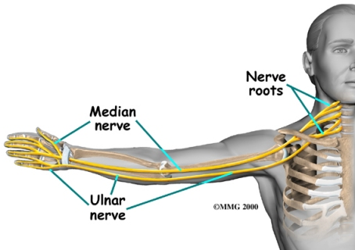
Nerve Impulse
All-or-None Response
Whenever a stimulus of threshold intensity is applied to a fiber, conduction of impulse happens.
All the impulses conducted on a fiber are of the same strength.

Slide 9
Have you ever wondered why you can’t feel anything when you are under anesthetic?
Certain local anesthetic drugs decrease membrane permeability to sodium ions. Such a drug in the fluids surround a nerve fiber prevents impulses from passing through the affected region. This keeps impulses from reaching the brain, preventing sensations of touch and pain.

Slide 10
Action Potentials
http://www.youtube.com/watch?v=DJe3_3XsBOg

Slide 11
Review Questions
1. Summarize how a nerve fibers become polarized.
2. List the major events that occur during an action potential.
Explain how impulse conduction differs in myelinated vs. unmyelinated fibers.
Define the all-or-none response.

Slide 12
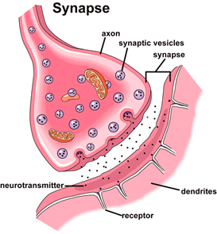
The Synapse
Junction between two neurons
Synaptic Cleft:
Gap that separates the two neurons.

Slide 13
Synaptic Transmission
Impulses usually travel from a dendrite to a cell body, then along the axon to a synapse.
Axons have synaptic knobs at their distal ends, which secrete neurotransmitters.
Neurotransmitter is released when a nerve impulse reaches the end of an axon.
A neurotransmitter reaching the nerve fiber on the distal side of the synaptic cleft triggers a nerve impulse.

Slide 14
Excitatory and Inhibitory Actions
Neurotransmitters that trigger nerve impulses are excitatory, those that inhibit are inhibitory.
The net effect of synaptic knobs communicating with a neuron depends on which knobs are activated from moment to moment.

Slide 15
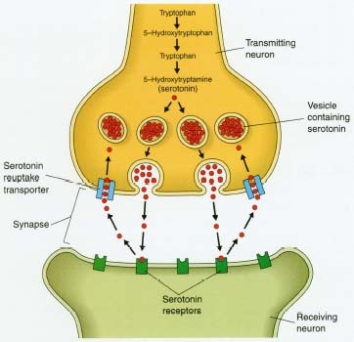
Neurotransmitters
Examples: Acetylcholine, monoamines, amino acids, and peptides
Synaptic knob releases neurotransmitters when an action potential increases membrane permeability to calcium ions.
After being released, neurotransmitters are decomposed or removed from synaptic clefts.

Slide 16
Impulse Processing
How the nervous system processes and responds to nerve impulses reflects the organization of neurons in the brain and spinal cord.
Neuronal Pools
Formed within CNS
Each pool receives impulses, processes them, and conducts impulses away.

Slide 17
Impulse Processing
Facilitation
Each neuron in a pool may receive excitatory and inhibitory stimuli
A neuron is facilitated when it receives subthreshold stimuli and becomes more excitable.

Slide 18
Impulse Processing
Convergence
Impulses from two or more incoming fibers may converge on a single neuron.
Convergence enables impulses from different sources to have an additive effect on a neuron

Slide 19
Impulse Processing
Divergence
Impulses leaving a pool may diverge by passing into several output fibers
Divergence amplifies impulses.

Slide 20
Review Questions
1. Describe the function of a neurotransmitter.
2. distinguish between excitatory and inhibitory actions of neurotransmitters.
3. Define neuronal pool.
Distinguish between convergence and divergence.

Slide 21
Types of Nerves
Nerves are cordlike bundles of nerve fibers.
Classification:
Sensory
Motor
Mixed-Both sensory and motor
All depends on which fibers they contain.

Slide 22
Nerve Pathways
A nerve pathway is a route an impulse follows through the nervous system.
Reflex Arcs
Usually includes a sensory neuron, reflex center composed of interneurons, and a motor neuron.

Slide 23
Reflexes
Reflex Behavior
Reflexes are automatic, subconscious responses to changes
They help to maintain homeostasis
The knee-jerk reflex employs only two neurons
Withdrawal reflexes are protective

Slide 24
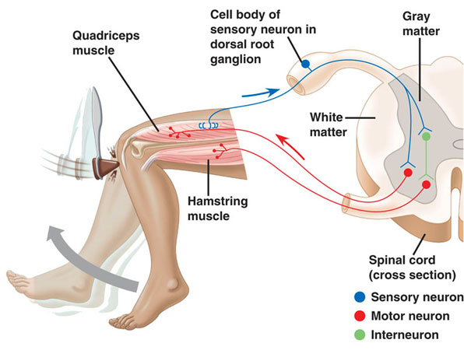

Slide 25
Review Questions
1. What is a nerve pathway?
2. List the parts to a reflex arc.
3. Define reflex.
4. Review the actions that occur during a withdrawal reflex.

