Slide 1
Sense of Taste

Slide 2
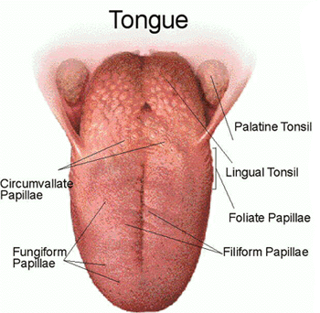
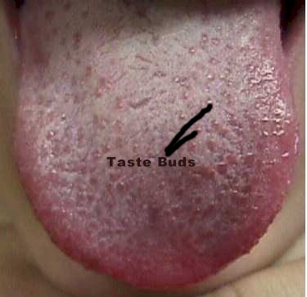
Taste Buds
Special organs of taste
Approximately 10,000 on surface of tongue
1,000 scattered in the roof of mouth and walls of throat
Associated with Papillae
Tiny elevations on tongue

Slide 3
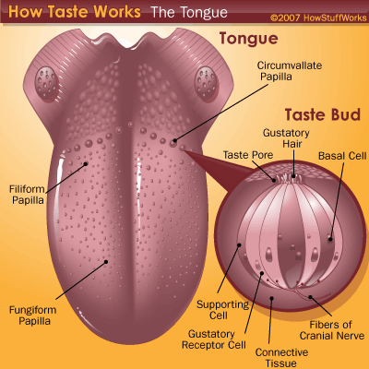
Taste Receptors
Taste Cells
50-150 on each taste bud
AKA Gustatory cells
Replaced on avg. every 10 days
Taste Pore
Opening to taste cells
Taste Hairs
Tiny projections that protrude from the outer ends of taste cells
Most sensitive parts
Network of nerve fibers interwoven around taste cells

Slide 4
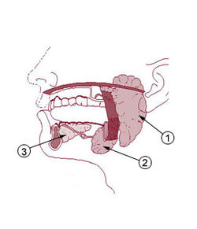
Chemoreceptors
Salivary Glands
Produce water fluid surrounding taste cells that chemicals must dissolve in in order for the taste to be tasted.
Food molecules bind to specific receptor proteins embedded in taste hairs
Pattern of receptor types stimulated generates sensory impulses
All taste cells in all taste buds appear alike microscopically but 5 specific types of buds.

Slide 5
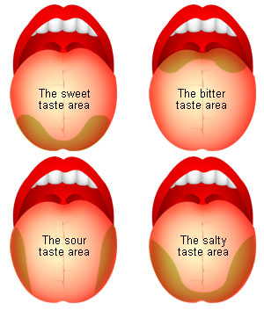
Taste Sensations
5 Primary Tastes
Sweet-tip of tongue
Table sugar
Sour-sides of tongue
Lemon
Salty-all over tongue
Table salt
Bitter-back of tongue
Caffeine
Umami (Japanese term meaning delicious)
Anything that you think is delicious
Others not believe by all scientists:
Alkaline-like bitter (Coffee)
Metallic-metal fork, tinfoil

Slide 6
Taste Sensation Cont.
Flavor results from one or more combinations of primary sensations
Also includes: smelling, feeling texture, and temperature
Pain Receptor
Stimulated by chili peppers, ginger etc.
Taste Cells respond to one sensation and are found throughout tongue
Most strong in certain regions

Slide 7
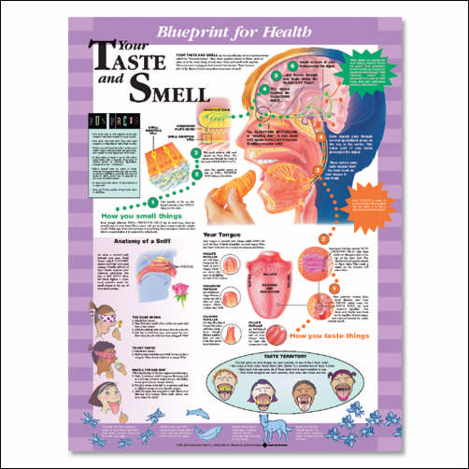
Adaption
Like smell, taste adapts rapidly
Moving food all over surface of tongue stimulates different receptors preventing taste loss through sensory adaption.

Slide 8
Nerve Pathways
Cranial Nerves
Facial
Glossopharyngeal
Vagus
Flow to Medulla Oblongta
Then Ascend to Thalamus and further to gustatory cortex in parietal lobe.

Slide 9
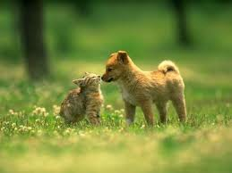
Interesting Fact
Cats and dogs may be satisfied with less varied diets than humans because cats have only 473 taste buds and dogs about 1,700.

