Slide 1
Special Senses

Slide 2
Special Senses
Sensory receptors are large, complex sensory organs found in the head.
Smell
Olfactory Organs
Taste
Taste Buds
Hearing and Equilibrium
Ears
Sight
Eyes

Slide 3
Sense of Smell
Associated with complex sensory structures in upper region of nasal cavity.
Olfactory Receptors
Chemoreceptors
Chemicals dissolve in liquids to stimulate them
Functions closely with taste
Aids in food selection

Slide 4
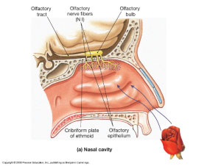
Olfactory Organs
Yellowish, brown masses of epithelium that cover the upper parts of the nasal cavity
Superior Nasal Conchae
Nasal Septum
Olfactory Receptor Cells
Bipolar neurons surrounded by columnar epithelial cells
Cilia covers ends of dendrites and harbor olfactory receptor proteins
Odorant molecules enter nose and stimulate receptor proteins
Signal is sent to brain to detect odor
Odorant molecules enter nose as a gas and must be dissolved in the watery fluid in nose before odor can be detected.

Slide 5
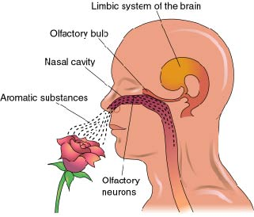
Olfactory Nerve Pathways
1st Cranial Nerve
Olfactory Bulb:
Enlarged knob on end of Olfactory Nerve
Impulses are analyzed and then sent on to the limbic system through olfactory tracts
Major interpreting area is the olfactory cortex located within the temporal lobes, base of frontal lobe and anterior to the hypothalamus

Slide 6
Olfactory Stimulation
Several hundred types of olfactory receptor cells can code for thousands of odors.
Odorant molecule stimulates a distinct set of receptor types
Brain interprets code to tell you what your smelling
Example: chocolate might stimulate receptors 1, 5, and 10.

Slide 7
Adaption
Sense of smell adapts rapidly
But just because you adapt to one scent doesn’t mean you will lack ability to smell other things.

Slide 8
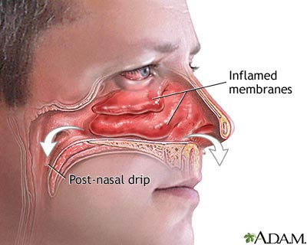
Lack of Smell
Partial or complete loss of smell is called anosmia. It may result from inflammation of the nasal cavity lining due to a respiratory infection, tobacco smoking, or using certain drugs, such as cocaine.

Slide 9
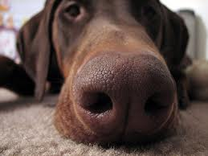
Smell Fact
Humans smell the world using about 12 million olfactory receptor cells, but dogs have more than a billion such cells. Canines’ excellent sense of smell is the basis of using service dogs to detect impending health problems in their owners. The dogs sense subtle odors that people emit when becoming ill in certain ways. Service dogs are used to sense imminent seizures, drops in blood glucose and heart rate, and lung, breast, and thyroid cancers. Experiments confirm that dogs are especially sensitive to odorant molecules on the skin or in the sweat of sick people.

