Slide 1
The Brain
Day 4

Slide 2
How many neurons?
About 100 billion multipolar neurons
Innumberable nerve fibers
Allow the neurons to communicate with one another and to other parts of nervous system.

Slide 3
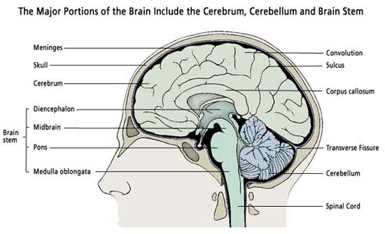

Slide 4
Three Major Parts
Cerebrum
Largest, contains nerve centers associated with sensory and motor functions, provides higher mental functions including memory and reasoning
Cerebellum
Center that coordinates voluntary muscular movements
Brain Stem
Includes the DIENCEPHALON
Processes sensory information
Connects various parts of nervous system, regulates certain visceral activities

Slide 5
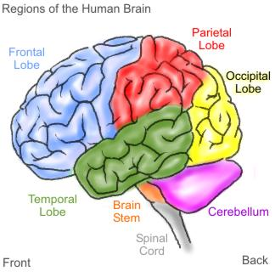
Structure of Cerebrum

Slide 6
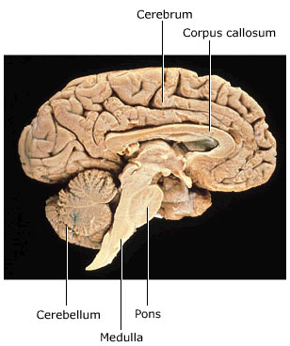
Structure of Cerebrum
Cerebral Hemispheres
Right and Left Halves
Layer of Dura Mater separates
Corpus Callosum-bridge of nerve fibers
Connects hemispheres

Slide 7
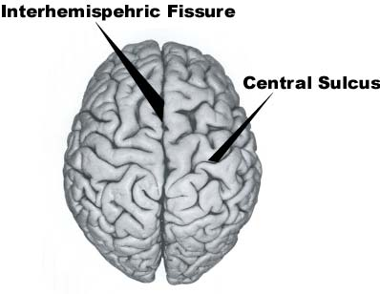
Structure of Cerebrum
Surface contains many ridges called convolutions (gyri) that are separated by grooves.
Sulcus
Shallow groove
Fissure
Deep groove
Very complex compressions but form distinct patterns in normal brains.

Slide 8
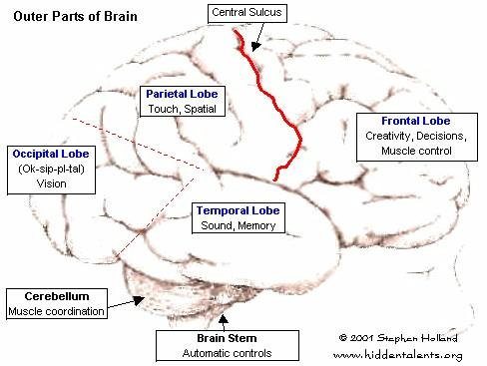
Important Fissures and Sulcuses
Longitudinal Fissure
Separates R and L hemispheres
Transverse Fissure
Separates cerebrum from cerebellum
Central Sulcus
Divides frontal lobe from parietal lobe

Slide 9
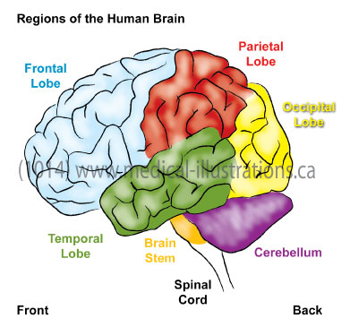
Cerebrum Lobes
Names after their skull bones they lie under
Frontal Lobe
Anterior portion of each cerebral hemisphere
Divided by the longitudinal fissure, central sulcus, and lateral sulcus.
Parietal Lobe
Posterior to the frontal lobe and separated by central sulcus.

Slide 10
Cerebral Lobes Cont.
Temporal Lobe
Lies below frontal lobe
Separated by lateral sulcus
Occipital Lobe
Posterior portion of cerebral hemisperes
Boundary between parietal and temporal lobe is not clear
Insula
Located deep within lateral sulcus
Covered by parts of frontal, parietal, and temporal lobes
Separated by circular sulcus

Slide 11
Cerebral Cortex
Thin layer of gray matter
Outer most portion of cerebrum
Covers all the convolutions and goes into the sulci and fissures
Contains 75% of all neuron cell bodies in the nervous system

Slide 12
Functions of Cerebrum
HIGHER BRAIN FUNCTIONS
Center for interpreting sensory impulses arriving from sense organs
Center for initiating voluntary muscular movements
Stores information of memory
Utilizes reasoning
Responsible for intelligence and personality

Slide 13
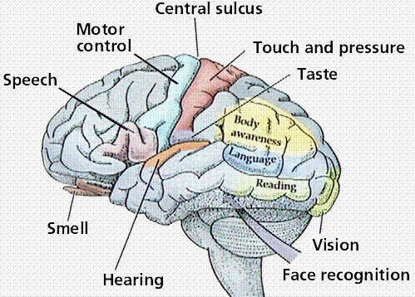
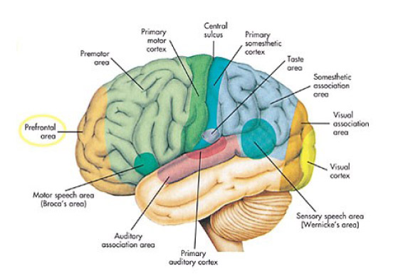
Functional Regions of Cerebral Cortex
Divided into motor, sensory, and associational areas

Slide 14
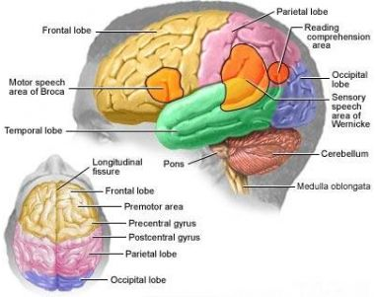
Primary Motor Areas
Frontal Lobe just in front of
central sulcus
Because of the cross over of
nerve tracts, right hemisphere contains skeletal muscles on left side and vice versa
Motor Speech Area=Boca’s Area
Coordinates muscular actions of mouth, tongue, and larynx

Slide 15
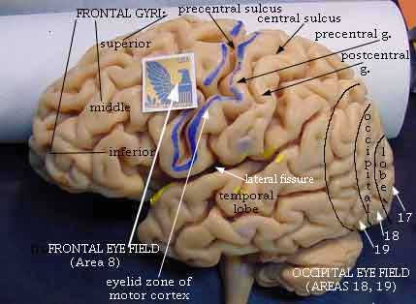
Motor Function Areas
Frontal Eye Field
Located above Boca’s
area
Voluntary movements of
eyes and eyelids
Other region in front of primary motor area makes movements of hands and fingers possible
Writing

Slide 16
Sensory Areas
Found within several lobes
Interpret impulses that arrive from sensory receptors producing, feelings and sensations.
Skin sensations arise from anterior portions of parietal lobe along central sulcus.
Occipital lobe affects vision
Temporal lobe affects hearing

Slide 17
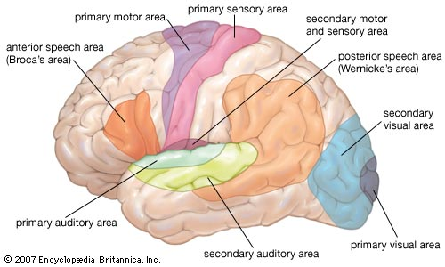

Slide 18
Sensory Areas
Taste is found near base of central sulci and lateral sulci
Smell comes from deep within the cerebrum
Same as motor functions, nerves cross each other causing sensation on right side of body to be interpreted in left side of brain and vice versa.

Slide 19
Association Areas
Neither primary sensory or motor
Connect with one another and other brain structures
Analyze and interpret sensory experiences and oversee memory, reasoning, verbalizing, judgment, and emotion.
Found on anterior portion of frontal lobe and throughout the lateral portions of parietal, temporal and occipital lobes.

Slide 20
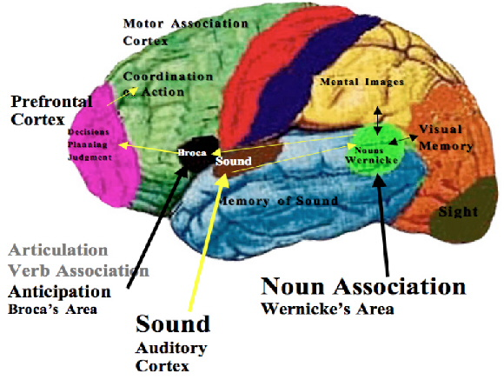

Slide 21
Association Areas
Frontal Lobes
Controls concentrating, planning, complex problem solving, judging the possible consequences of behavior
Parietal Lobes
Understanding speech and choosing words to express thoughts and feelings

Slide 22
Association Areas
Temporal Lobes
Complex sensory experiences (those needed to understand speech and to read), memory of visual scenes, music, and others.
Occipital Lobes
Analyzing visual patterns, combining visual images with other sensory experiences
General interpretative area
Where parietal, temporal and occipital areas meet
Plays primary role in complex thought procesing

Slide 23
Review
List the major divisions of the brain.
Describe the cerebral cortex
What are the major functions of the cerebrum?

Slide 24
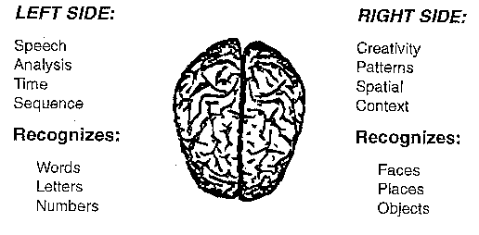
Hemisphere Dominance
Both hemispheres receive and analyze sensory info, control skeletal muscles, and store memory.
One side just tends to do it more than the other leading to a dominant hemisphere.

Slide 25
Hemisphere Dominance
90% of population is left side dominant for:
Language related activities
Speech, writing, and reading
Complex intellectual functions requiring verbal, analytical, and computational skills
Non-dominant side
Specializes in nonverbal functions such as motor tasks, understanding and interpreting musical patterns, and nonverbal visual experiences.
Emotional and intuitive thinking

Slide 26
Hemisphere tid-bit
The left hemisphere is dominant in 90% of right-handed adults and in 64% of left-handed ones. The right hemisphere is dominant in 10% of right-handed adults and in 20% of left-handed ones. The hemispheres are equally dominant in the remaining 16% of left-handed persons. Because of hemisphere dominance, Boca’s area on one side almost completely controls the motor activities associated with speech. For this reason, over 90% of patients with language impairment involving the cerebrum have disorders in the left hemisphere.

Slide 27
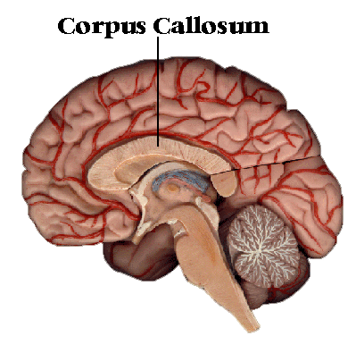
Hemisphere Dominance
Corpus callosum is responsible for allowing dominant hemisphere to control motor cortex of non-dominant side.
Also transfer sensory info from non-dominant side to dominant side so it can be used in decision making

Slide 28
Basal ganglia
Gray matter deep within each hemisphere
Made up of:
Caudate nucleus, putamen, and globus pallidus
Neuron bodies serve as a relay station for motor impulses
Produce inhibitory neurotransmitter dopamine
Inhibit motor functions thus controlling various skeletal muscle activities.

Slide 29
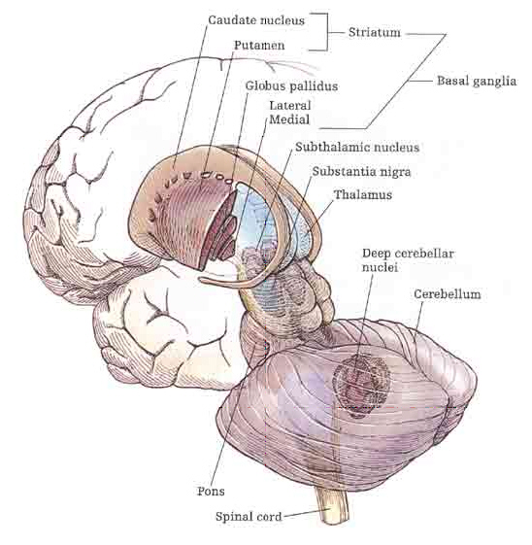
Basal Ganglia

Slide 30
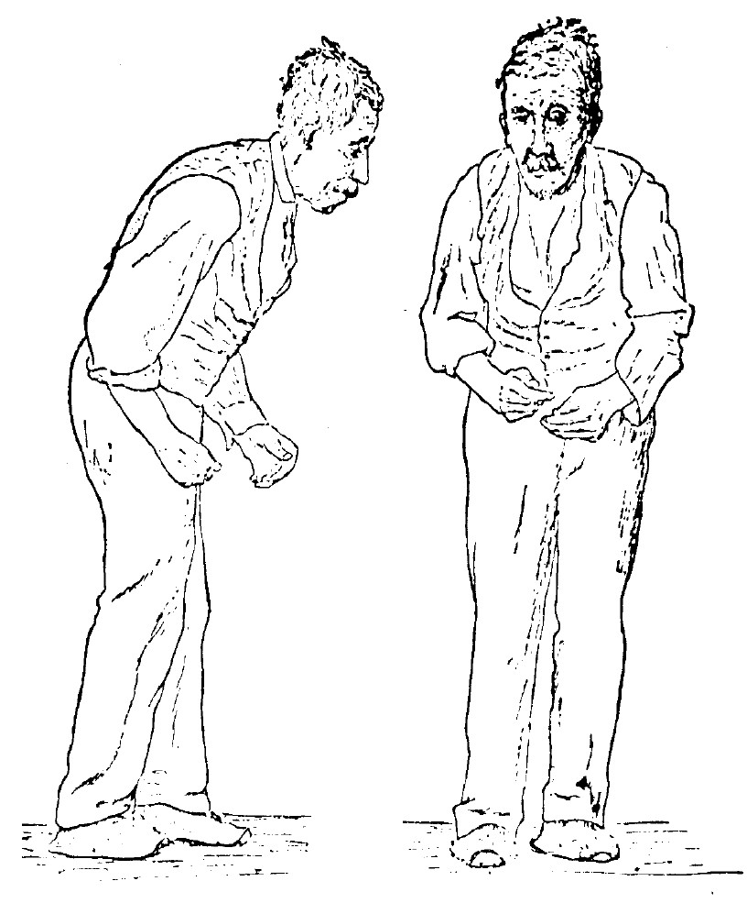
Basal Ganglia Tid-Bit
The uncontrollable movements of Parkinson disease and Huntington disease result from lesions in the basal ganglia. The lack of inhibiting impulses cause the excessive movements.

Slide 31
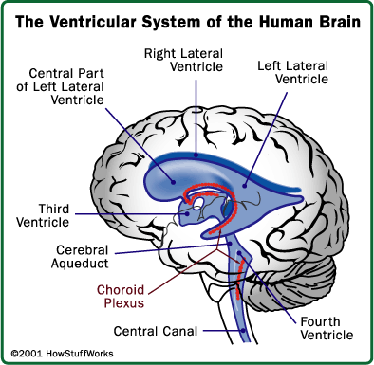
Ventricles and Cerebrospinal Fluid
Ventricles
Series of interconnected cavities within cerebral hemispheres that contains cerebrospinal fluid
Largest are the lateral ventricles(1st and 2nd) which extend into the frontal,
temporal and occipital lobes.
3rd ventricle is in the midline
of brain
4th ventricle is in brain stem

Slide 32
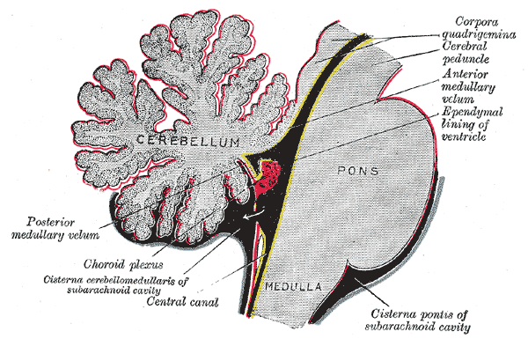
Choroid plexuses
Tiny-reddish cauliflower-like mass of specialized capillaries from the pia mater that secretes cerebrospinal fluid
Because of the ventricles allowing movement of cerebrospinal
fluid, the brain is
said to float.
This aids in
protection to the
brain and spinal
cord.

Slide 33
Cerebrospinal Fluid Tid-Bit
Because cerebrospinal fluid is secreted and reabsorbed continuously, the fluid pressure in the ventricles normally remains relatively constant. AN infection, a tumor, or a blood clot can interfere with fluid circulation, increasing pressure within the ventricles and thus in the cranial cavity. This can injure the brain by forcing it against the rigid skull. A lumbar puncture (spinal tap) is used to measure the pressure of cerebrospinal fluid. In the procedure, a fine, hollow needle is inserted into the subarachnoid space between the 3rd and 4th or 4th and 5th lumbar vertebrae. An instrument called a manometer measures the pressure.

Slide 34
Review
What is hemisphere dominance?
What are the major functions of the dominate hemisphere? The non-dominant one?
Where are the ventricles of the brain?

